Slide 1
IT2070 – Data Structures and Algorithms
Lecture 08
Heap Sort Algorithms
U. U. Samantha Rajapaksha
M.Sc.in IT, B.Sc.(Engineering) University of Moratuwa
Senior Lecturer SLIIT
Samantha.r@slit.lk

Slide 2
Contents for Today
Tree
Binary Tree
Complete Binary Tree
Heaps
Heap Algorithms
- Maintaining Heap Property
- Building Heaps
- HeapSort Algorithms

Slide 3
Height of a Full Binary Tree
A Full binary tree of height h that contains exactly 2^{h+1}-1 nodes
Height, h = 2, nodes = 2²⁺¹-1= 7

Slide 4
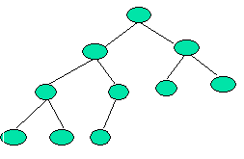
Height of a complete binary tree
Height of a complete binary tree that contains n elements is ⎣log₂(n)⎦
Example
Above is a Complete Binary Tree with height = 3
No of nodes: n = 10
Height = ⎣log₂(n)⎦ = ⎣log₂(10)⎦ = 3

Slide 5
Heaps
Heap is an array object that can be viewed as a complete binary tree. There are two kinds of heaps
max heaps and min heaps
In both case, values in the nodes satisfy Heap Property which depend on the kind of heap
max-heap → max-heap property:
The value of each node is greater than or equal to those of its children.
min-heap → min-heap property:
The value of each node is less than or equal to those of its children.
Max-heaps are used in heapsort algorithm

Slide 6
Heaps
Complete Binary Tree with the max-heap property - examples
14
14
12
7
12
7
10
8
6
10
8
6
5
4
3

Slide 7
Heaps (contd.)
A heap can be represented in a one-dimensional array
1
Example
16
2
3
14
10
4
5
6
7
8
7
9
3
Max Heap
8
9
10
2
4
1
A
1 2 3 4 5 6 7 8 9 10
16 | 14 | 10 | 8 | 7 | 9 | 3 | 2 | 4 | 1
Array

Slide 8

Heaps (contd.)
After representing a heap using an array A
Root of the tree is A[1]
Given node with index i,
PARENT(i) is the index of parent of i;
PARENT(i) = ⎣i/2⎦
LEFT_CHILD(i) is the index of left child of i ;
LEFT_CHILD(i) = 2×i
RIGHT_CHILD(i) is the index of right child of i;
RIGHT_CHILD(i) = 2×i +1

Slide 9
Heap Algorithms
MAX_HEAPIFY:
To maintain max-heap property
BUILD_MAX_HEAP
To build max-heap from an unsorted input array
HEAPSORT
Sorts an array in place.
A[PARENT(i)] ≥ A[i]

Slide 10
MAX_HEAPIFY
The MAX_HEAPIFY algorithm checks the heap elements for violation of the heap property and restores max-heap property;
Input: An array A and index i to the array. i =1 if we want to heapify the whole tree. Subtrees rooted at LEFT_CHILD(i) and RIGHT_CHILD(i) are heaps
Output: The elements of array A forming subtree rooted at i satisfy the heap property.
A[PARENT(i)] ≥ A[i]

Slide 11
Maintaining the Heap Property
MAX_HEAPIFY (A,i)
1. l = LEFT(i);
2. r = RIGHT(i);
3. if l ≤ A.heap_size and A[ l ] > A[ i ]
4. largest = l;
5. else largest = i;
6. if r ≤ A.heap_size and A[r] > A[largest]
7. largest = r;
8. if largest ≠ i
9. exchange A[i] with A[largest]
10. MAX_HEAPIFY (A,largest)

Slide 12
Example
You are given the following array
A
1 2 3 4 5 6 7 8 9 10
7 | 24 | 19 | 21 | 14 | 03 | 10 | 2 | 13 | 11
Now we are going to maintain the max-heap property
Drawing a heap would make our work easy
7
24
19
21
14
03
10
2
13
11

Slide 13

MAX_HEAPIFY (A,1)
1
1
24 > 19
7
24
2
3
2
3
24
19
4
7
6
19
4
5
6
7
5
7
21
14
03
10
21
14
03
10
8
9
10
8
9
10
2
13
11
2
13
11
MAX_HEAPIFY (A,2)
1
2
24
1
3
2
24
21
6
19
3
7
4
7
5
6
19
4
5
7
7
14
03
10
9
21
14
03
10
8
10
8
2
13
11
9
10
2
13
11
MAX_HEAPIFY (A,4)
21 > 14
To be contd.

Slide 14
MAX_HEAPIFY (A,1) (contd.)
1
13 > 2
1
2
24
2
24
3
3
21
6
19
21
6
19
4
5
7
4
5
7
7
14
03
10
7
14
03
10
9
9
8
2
13
11
10
8
2
13
11
10
MAX_HEAPIFY (A,4)
Important point Although we represent this process using a heap actually all the task in done on the input array
1
2
24
3
21
6
19
4
5
7
13
14
03
10
9
8
2
7
11
10
Resulting Heap

Slide 15
Array view of MAX_HEAPIFY Algorithm
7 24 19 21 14 03 10 02 13 11
24 7 19 21 14 03 10 02 13 11
24 21 19 07 14 03 10 02 13 11
24 21 19 13 14 03 10 02 07 11
24
21
19
13
14
03
10
2
7
11

Slide 16
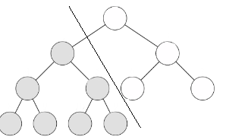
Analysis of Heapify Algorithm.
The running time of MAX-HEAPIFY on a subtree of size n rooted at given node i is the Θ(1) time plus the time to run MAX-HEAPIFY on a subtree rooted at one of the children of node i.
The children's subtrees -the worst case occurs when the last row of the tree is exactly half full
Alternatively, we can characterize the running time of MAX-HEAPIFY on a node of height h as O(h).
The solution to this recurrence is
T (n) = O(lg n)

Slide 17
BUILD_HEAP
Input : An array A of size n = A.length , A.heap_size
Output : A heap of size n
BUILD_MAX_HEAP (A)
1. A.heap_size =A.length
2. for i = ⎣A.length/2⎦ downto 1
3. MAX_HEAPIFY(A,i)
Exercise: We are given the following unordered array to build the heap.
A
1 2 3 4 5 6 7 8 9 10
4 | 1 | 3 | 2 | 16 | 9 | 10 | 14 | 8 | 7

Slide 18
Solution
Step1
i = ⎣length[A]/2⎦ = ⎣10/2 ⎦ =5
MAX_HEAPIFY(A,5)
i =5
A
1 2 3 4 5 6 7 8 9 10
4 | 1 | 3 | 2 | 16 | 9 | 10 | 14 | 8 | 7
1
4
2
3
4
1
5
3
2
16
9
10
14
8
7

Slide 19
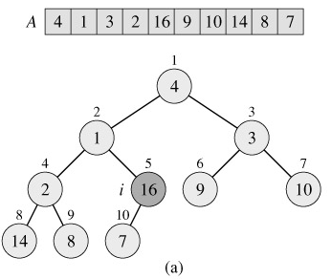
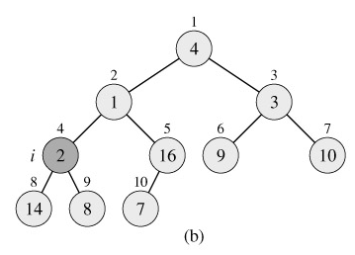
Solution (Contd.)
loop index i refers to node 5
loop index i for the next iteration refers to node 4

Slide 20
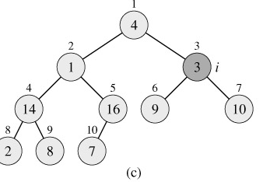
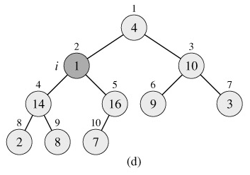
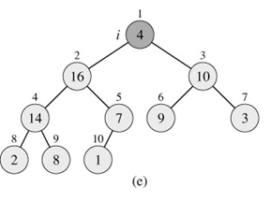
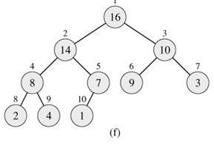
loop index i refers to node 3
loop index i refers to node 2
max-heap after BUILD-MAX-HEAP finishes.
loop index i refers to node 1

Slide 21
Analysis of Build Max Heap Algorithm.
Time for MAX-HEAPIFY to run at a node varies with the height of the node in the tree, and the heights of most nodes are small.
n-element heap has height ⌊lg n⌋
and
at most ⌈n/2^{h+1}⌉ nodes of any height h.

Slide 22
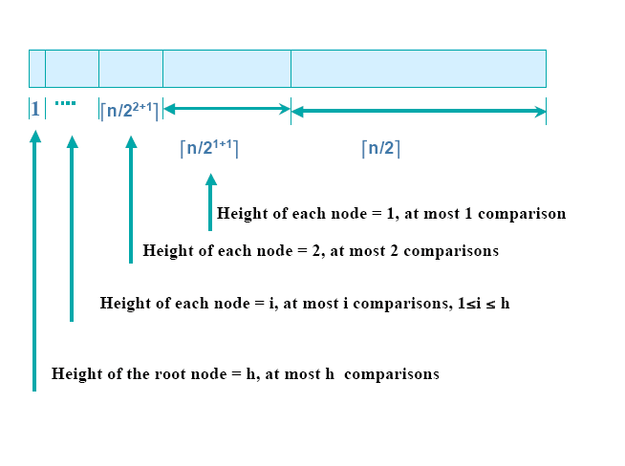
Analysis of Build Max Heap Algorithm.

Slide 23
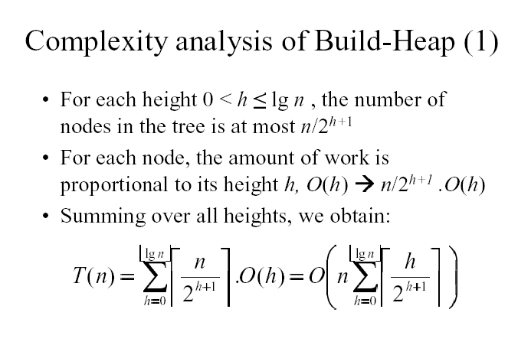

Slide 24
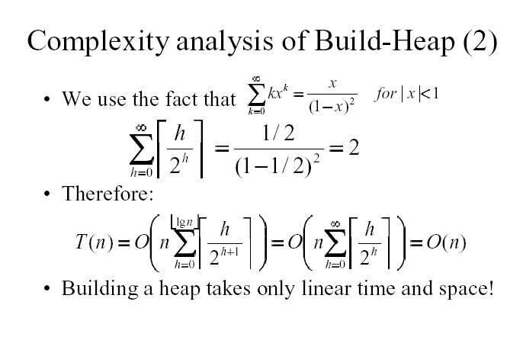

Slide 25
The HEAPSORT Algorithm
Input : Array A[1…n], n = A.length
Output : Sorted array A[1…n]
HEAPSORT(A)
1. BUILD_MAX_HEAP[A]
2. for i = A.length down to 2
3. exchange A[1] with A[i]
4. A.heap_size = A.heap_size - 1;
5. MAX_HEAPIFY(A, 1)

Slide 26
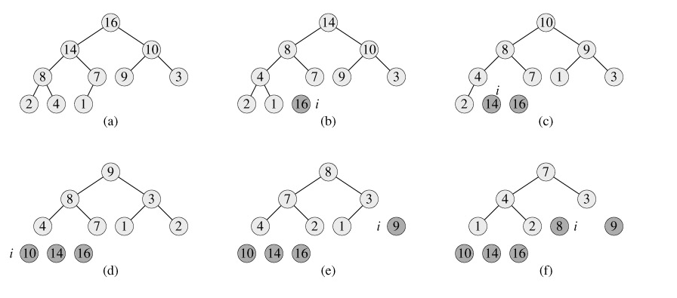
The operation of HEAPSORT.

Slide 27
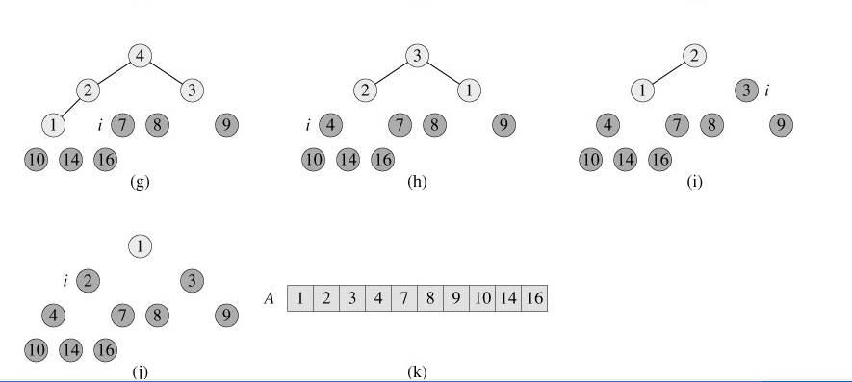
The operation of HEAPSORT.

Slide 28
Heapsort Complexity
Running Time:
Step1 : BUILD_MAX_HEAP takes O(n)
Step 2 to 5 : MAX_HEAPIFY takes O(log n) and there are (n -1) calls
Running Time is O(n log n)

Slide 29
Priority Queues
Heap data structure itself has many uses.
One of the most popular applications of a heap: its use as an efficient priority queue.
As with heaps, there are two kinds of priority queues:
- max-priority queues
- min-priority queues
We will focus here on how to implement max-priority queues, which are in turn based on max-heaps

Slide 30
Priority queues.
priority queue is a data structure for maintaining a set S of elements, each with an associated value called a key. A max-priority queue supports the following operations.
INSERT(S, x) inserts the element x into the set S. This operation could be written as S = S ∪ {x}.
EXTRACT-MAX(S) removes and returns the element of S with the largest key.

Slide 31
Priority queues.
One application of max-priority queues is to schedule jobs on a shared computer.
The max-priority queue keeps track of the jobs to be performed and their relative priorities. When a job is finished or interrupted, the highest-priority job is selected from those pending using EXTRACT-MAX. A new job can be added to the queue at any time using INSERT.

Slide 32
HEAP_EXTRACT_MAX
HEAP_EXTRACT_MAX(A[1 .. n])
This will remove the maximum element from heap and return it
Input : heap(A)
Output : Maximum element or root, heap(A[1..n-1])
1. if A.heap_size >= 1
max = A[1]
A[1] = A[A.heap_size]
A.heap_size = A.heap_size -1
MAX_HEAPIFY(A,1)
return max
Running time : O(log n)

Slide 33
HEAP_INSERT
HEAP_INSERT(A, key)
This will add a new element to the heap
Input : heap(A[1..n]), key - the new element
Output : heap(A[1..n+1 ]), with k in the heap
1. A.heap_size = A.heap_size + 1
2. i = A.heap_size // assume A[i] = - ∞
3. while i > 1 and A[PARENT(i)] < key
A[i] = A[PARENT(i)]
i = PARENT(i)
A[i] = key
Running time : O(lg n)

Slide 34
Summary
Complete binary Tree
Heap property
Heap
Maintaining heap Property(HEAPIFY)
Building Heaps
HeapSort Algorithm
Priority queues.
Heap Extract Max.
Heap Insert.

